Slide 1


Session // 03 TRAINING NEURAL NETWORKS FACULTY OF SCIENCE AND ENGINEERING +++
Diego Corona Lopez – AI Technical Specialist

Slide 2

Agenda
Introduction to Artificial Neural Networks
Understanding neural networks and their components
Exploring neuron structure and activation functions
PyTorch Workflow Overview
Case Study: ARKOMA Robot Dataset
Data Preparation and Model Design
Preprocessing and normalizing data
Designing network architecture
Training and Evaluation
Implementing loss functions and optimizers
Monitoring model performance
Results Analysis and Visualization
Challenges & Next Steps

Slide 3
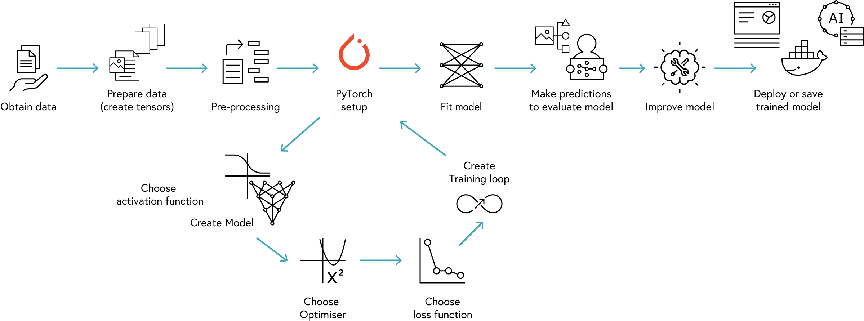
PYTORCH WORKFLOW

Slide 4
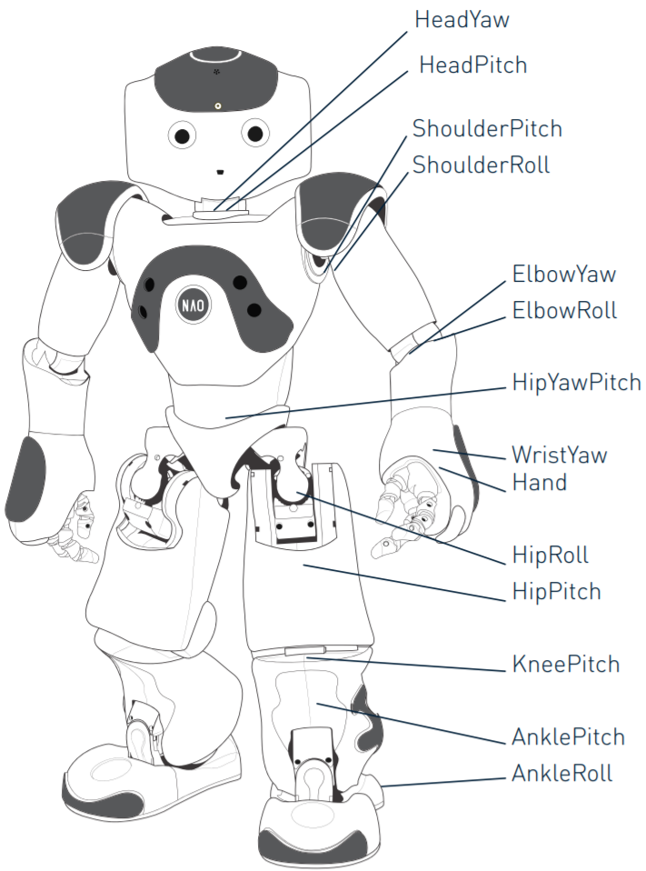
ARKOMA ROBOT Dataset
Critical problem in robotics:
"How should joints move to place end-effector at desired position?"
Why Inverse Kinematics Matter:
Forward kinematics: Easy to calculate (joint angles → position)
Inverse kinematics: Challenging mathematical problem (position → joint angles)
Real-world applications:
Robot manipulation tasks (grasping objects)
Manufacturing automation
Surgical robotics
NAO robot inverse kinematics dataset
10,000 input-output pairs
Inputs: End-effector positions (Px, Py, Pz, Rx, Ry, Rz)
Outputs: Joint angles (θ1, θ2, θ3, θ4, θ5)
We'll focus on the right arm
SE03
04

Slide 5
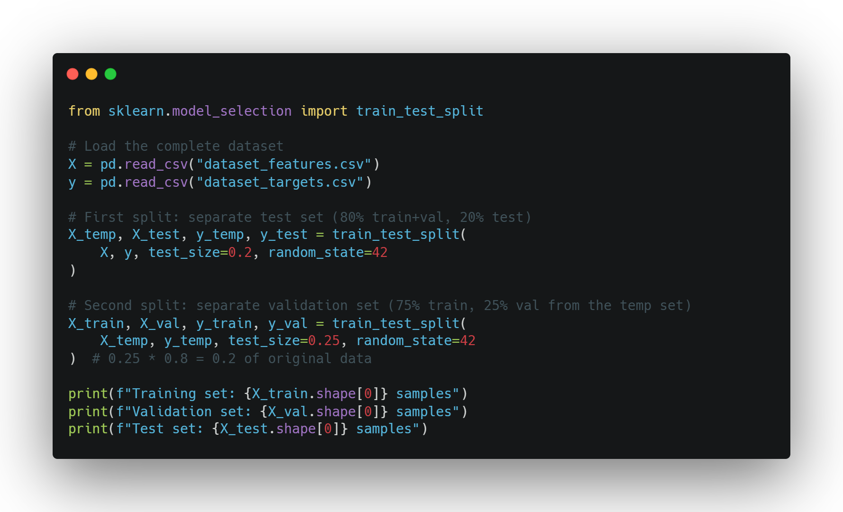
Data preparation and pre-processing
Purpose of each dataset:
Training (60-80%):
Training the model
Validation (10-20%):
Tuning hyperparameters
Test (10-20%):
Final evaluation

Slide 6
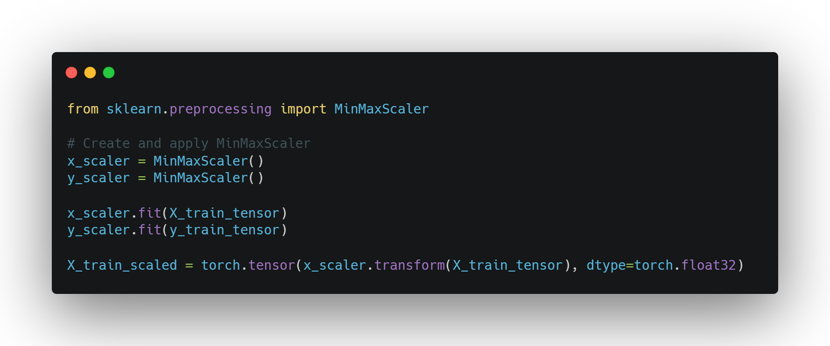
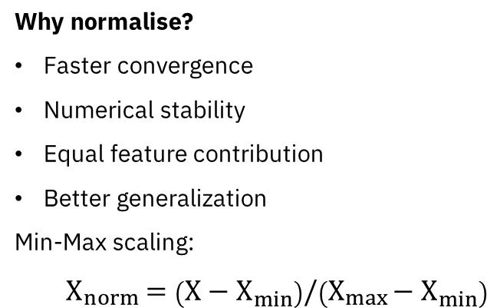
Data Normalisation
Why normalise?
Faster convergence
Numerical stability
Equal feature contribution
Better generalization
Min-Max scaling:
$$X_{norm}=\left(X−X_{min}\right)/\left(X_{max}−X_{min}\right)$$
SE03
06

Slide 7
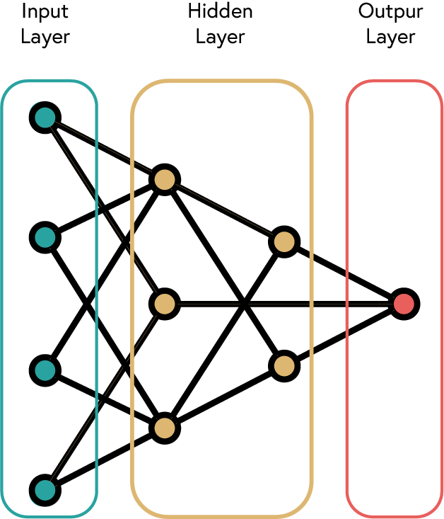
BUILDING
NEURAL NETWORKS
Input Layer: Receives input features
Hidden Layers: Process information
Output Layer: Produces predictions
Width (neurons per layer) vs Depth (number of layers)
SE03
07

Slide 8
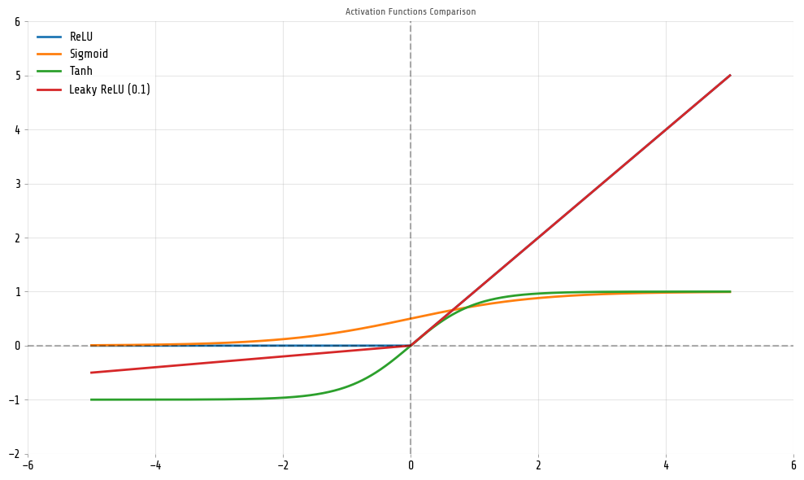
ACTIVATION FUNCTIONS
Purpose:
Transform linear input to non-linear output
Enable networks to learn complex patterns and relationships
Key properties:
Differentiable
Non-linear
Computationally efficient
SE03
08

Slide 9
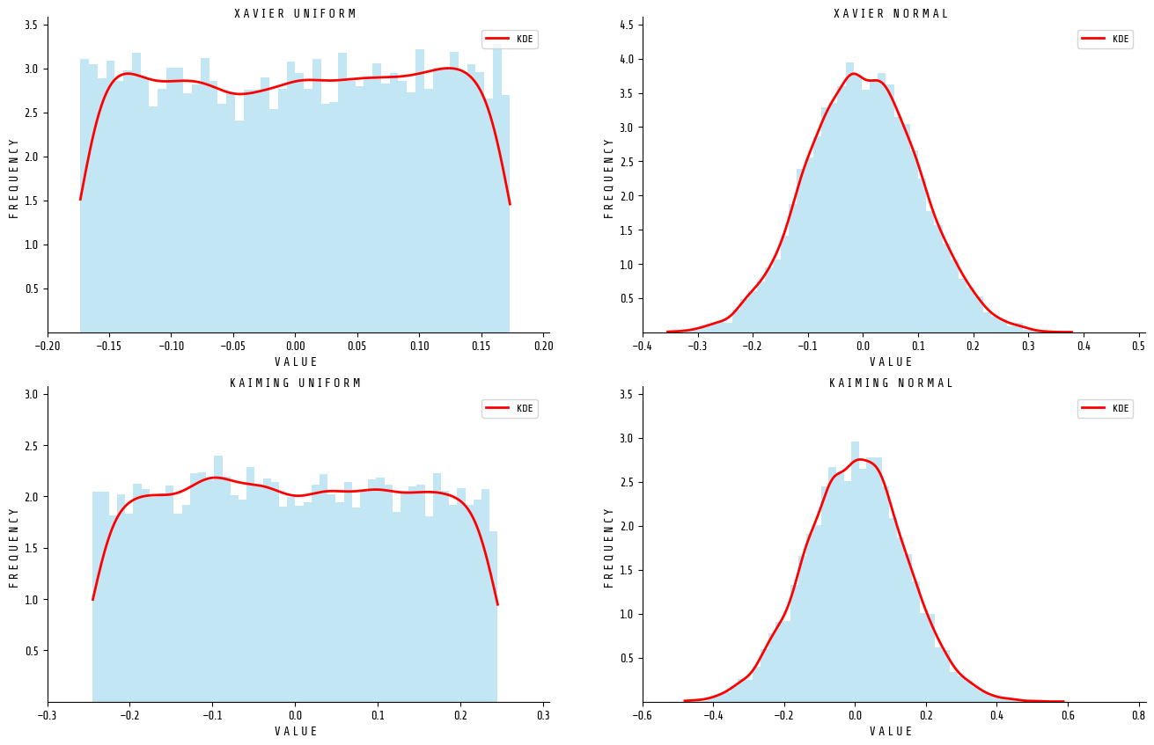
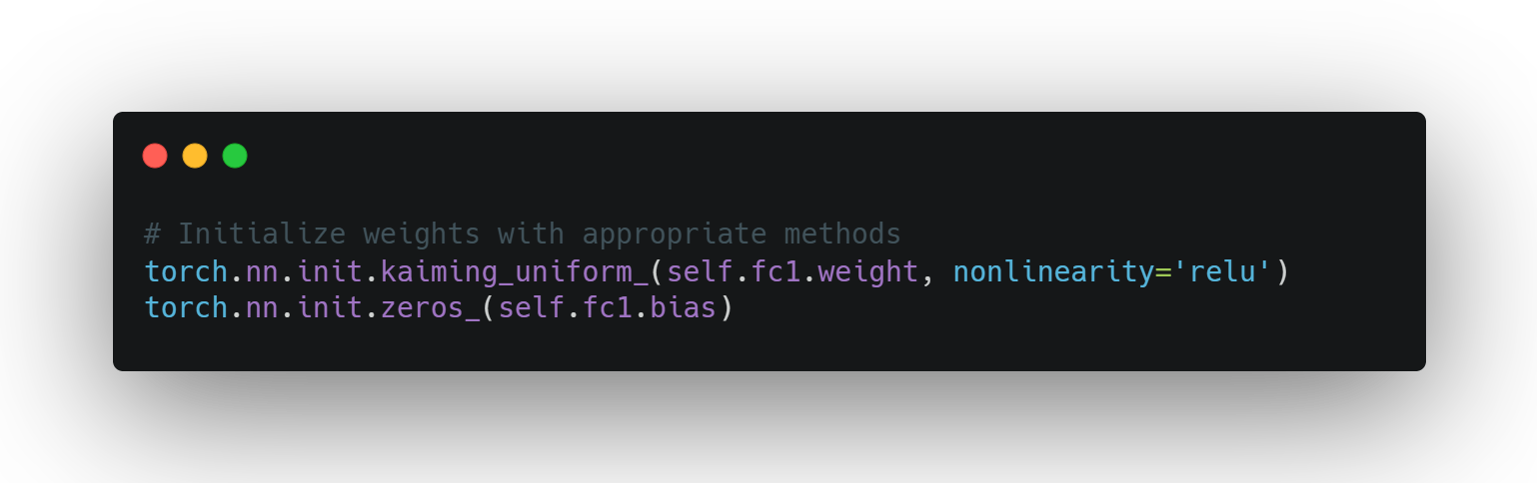
WEIGHT INITIALISATION
Importance of proper initialization:
Convergence Speed: Good initialization leads to faster training
Symmetry Breaking: Prevents neurons from learning the same features
Vanishing/Exploding Gradients: Proper scaling helps maintain gradient flow
Training Stability: Reduces the chance of getting stuck in poor local minima
Reproducibility: Sets a consistent starting point for experiments
SE03
09

Slide 10
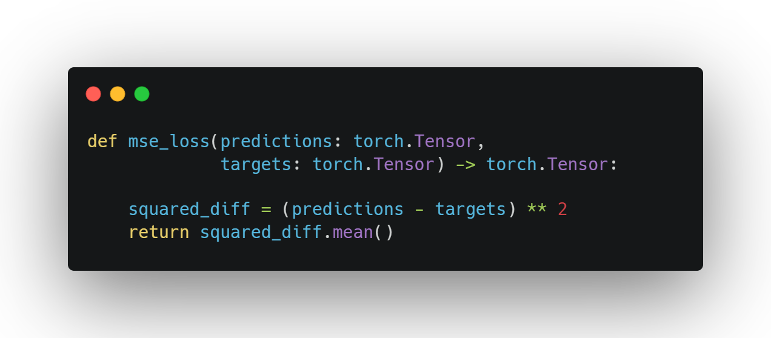
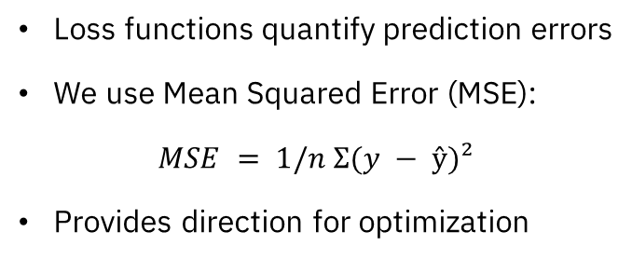
Loss function
Loss functions quantify prediction errors
We use Mean Squared Error (MSE):
$MSE = 1/n Σ(y − ŷ)²$
Provides direction for optimization
SE03
10

Slide 11
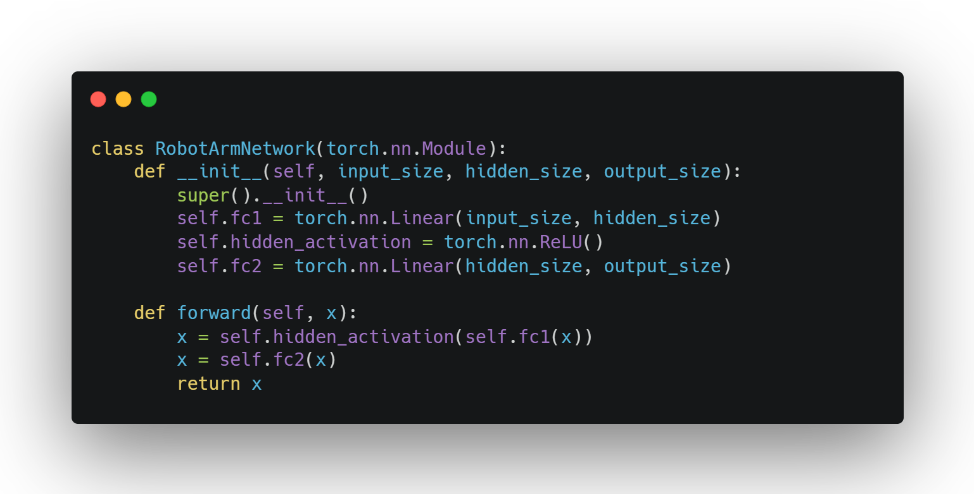
Ann implementation
PyTorch model implementation for robotic arm
Simple architecture to avoid overfitting
SE03
11

Slide 12
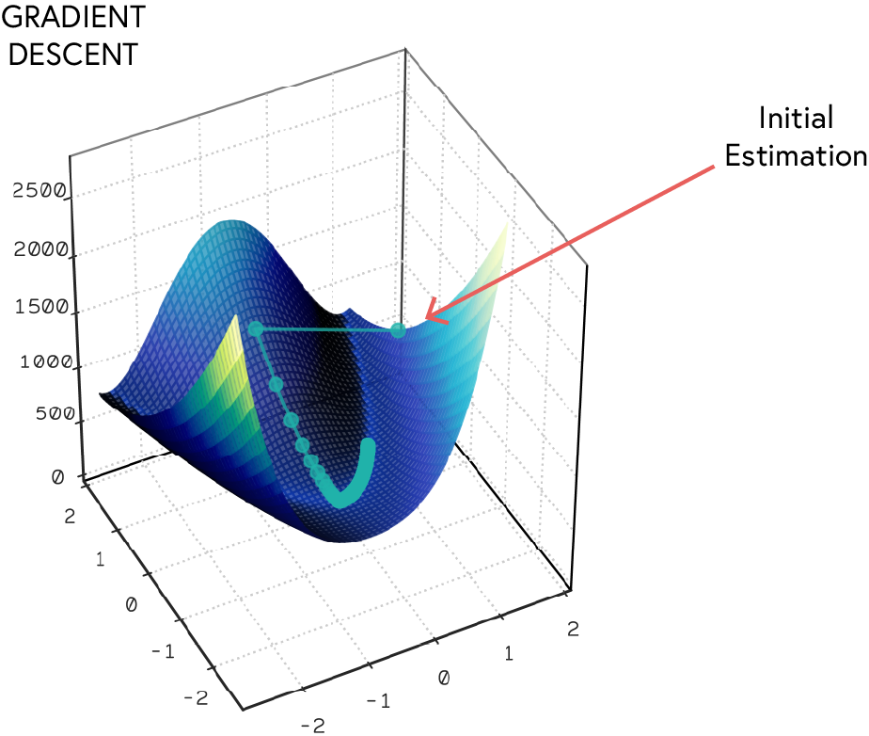
OPTIMISATION
Popular optimisers:
SGD: Simple, works well with momentum
Adam: Adaptive learning rates, widely used
RMSProp: Good for recurrent networks
AdamW: Adam with proper weight decayCritical importance:
Learning rate importance:
Too large: Causes unstable training, overshooting minima
Too small: Results in slow convergence or getting stuck in local minima
"Just right": Efficient convergence to good solutions
Learning Rate Strategies:
Fixed: Simple but rarely optimal for entire training
Decay/Scheduling: Reduce rate over time (e.g., step, exponential, cosine)
Adaptive: Adjusts automatically based on gradient history
SE03
12

Slide 13
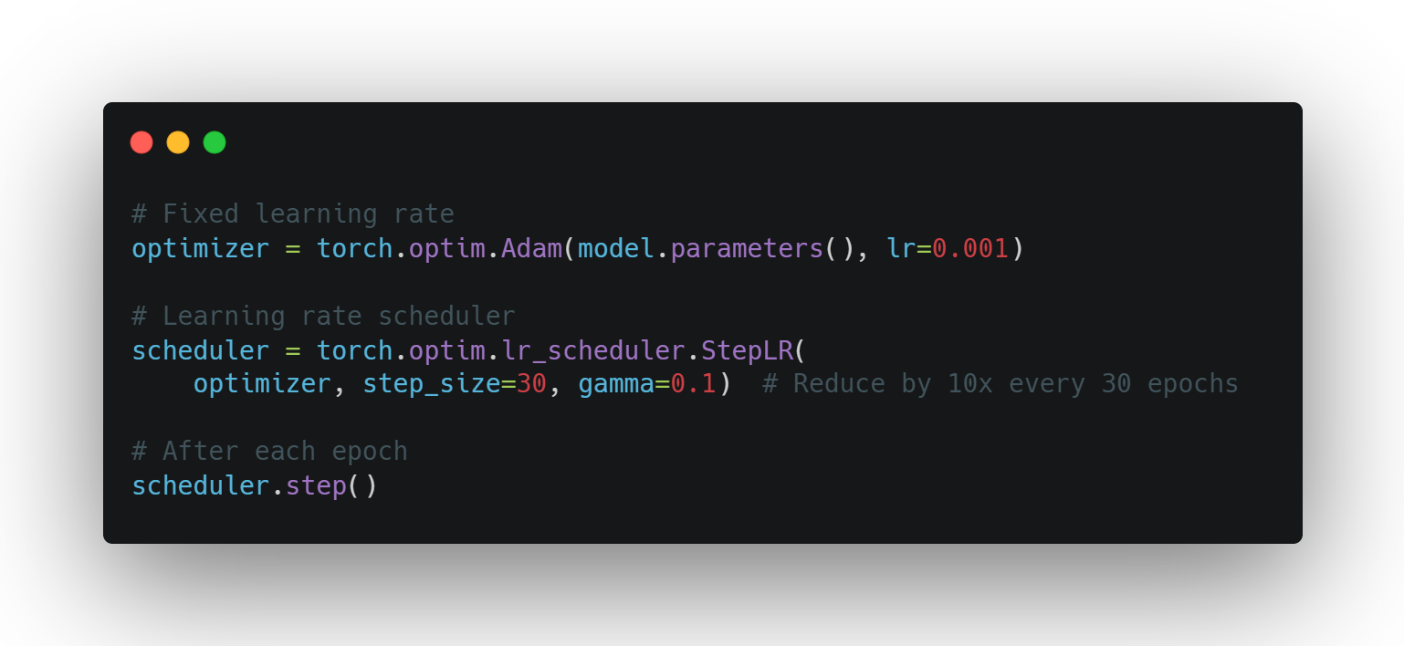
PYTORCH OPTIM
SE03
13

Slide 14
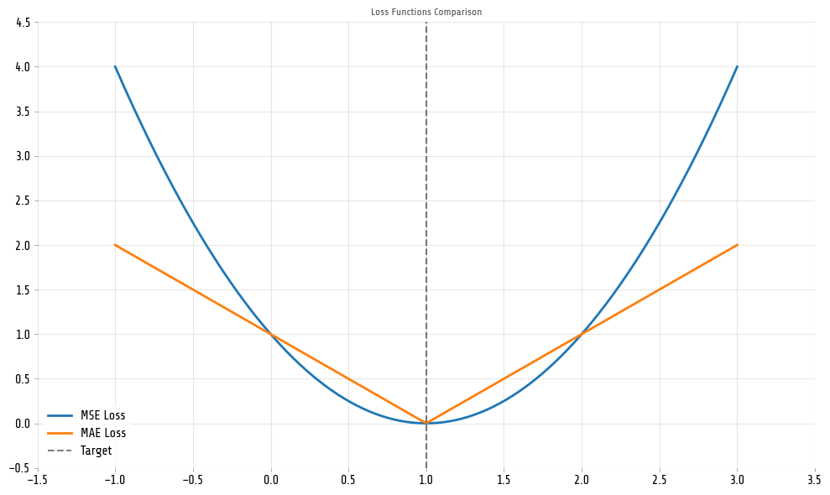
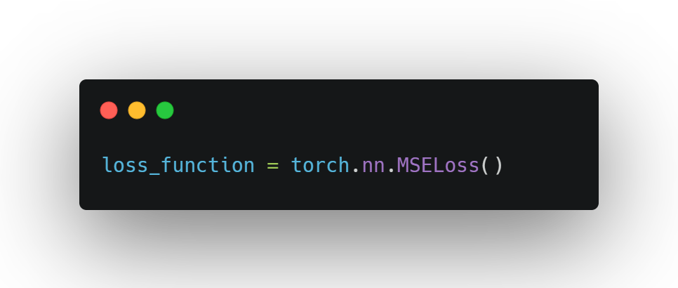
LOSS FUNCTIONS
Types of loss functions:
MSE: Regression tasks
MAE: Regression with less sensitivity to outliers
Binary Cross-Entropy: Binary classification
Categorical Cross-Entropy: Multi-class classification
For our regression task: Mean Squared Error
SE03
14

Slide 15
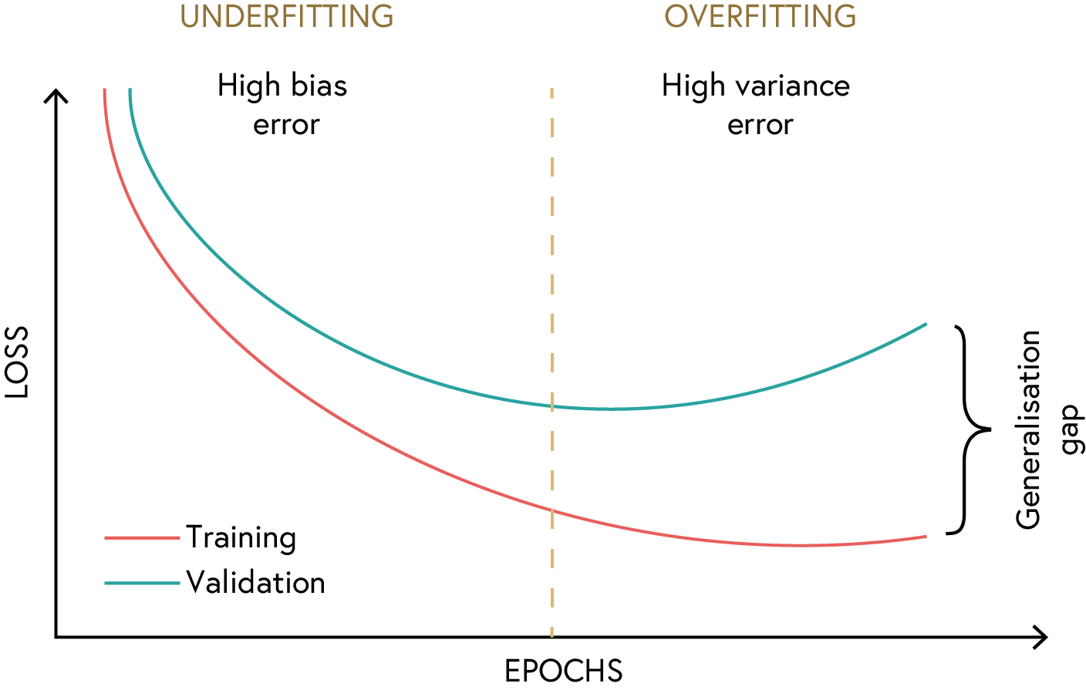
OVERFITTING AND UNDERFITTING
Underfitting: Model too simple, high bias
Overfitting: Model too complex, high variance
Finding the right balance
SE03
15

Slide 16
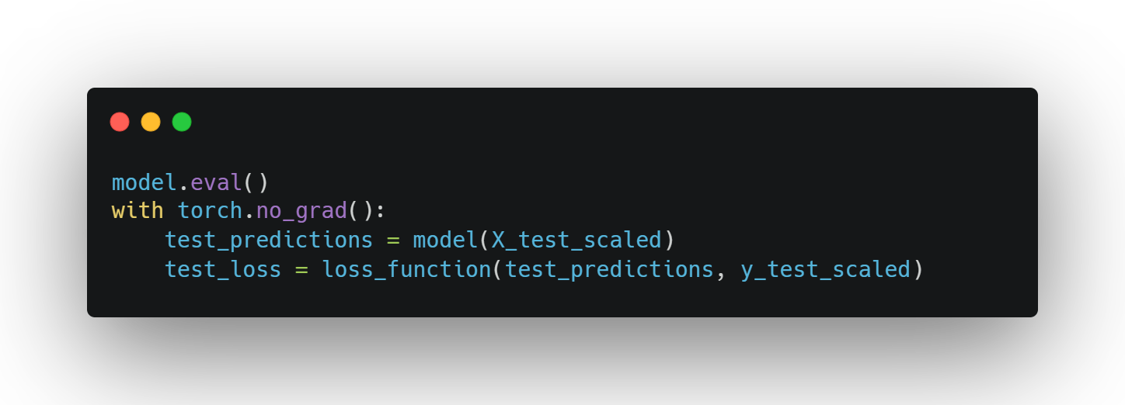
MODEL EVALUATION
Testing on unseen data
Metrics for regression:
Mean Squared Error
R-squared score
SE03
16

Slide 17
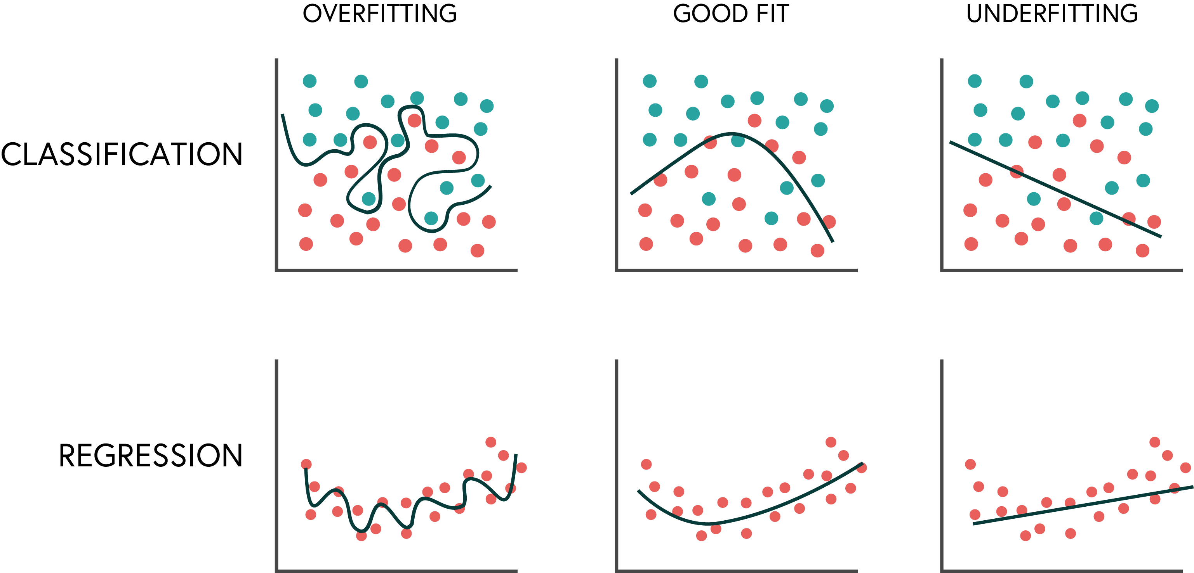
MODEL EVALUATION
SE03
17

Slide 18
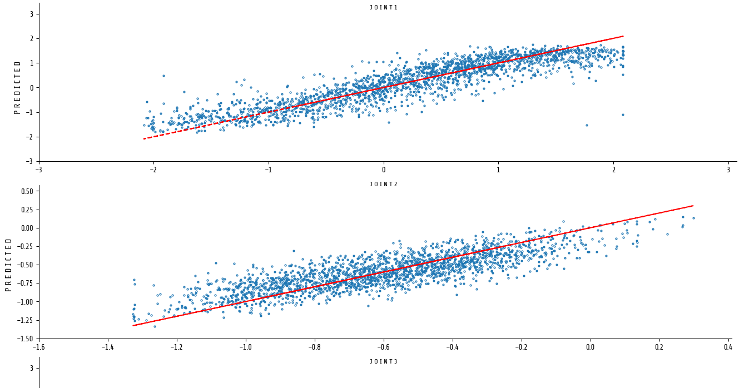
Improving the model
Hyperparameter tuning
Deeper/wider networks
Regularisation techniques
Advanced architectures

